Slide 1

Create an Epitech Campus of the Future
GOSSOT Jean-Baptiste B-ENG-100

Slide 2
Plan
Current Design of Epitech Nancy
Aspect of the campus that needs improvement
Adapt to people with mobility issues
Adapt to reduce cost and effects of energy usage
How would we use technology in the campus
Element of well-being and physical/mental health
Conclusion
GOSSOT Jean-Baptiste B-ENG-100

Slide 3
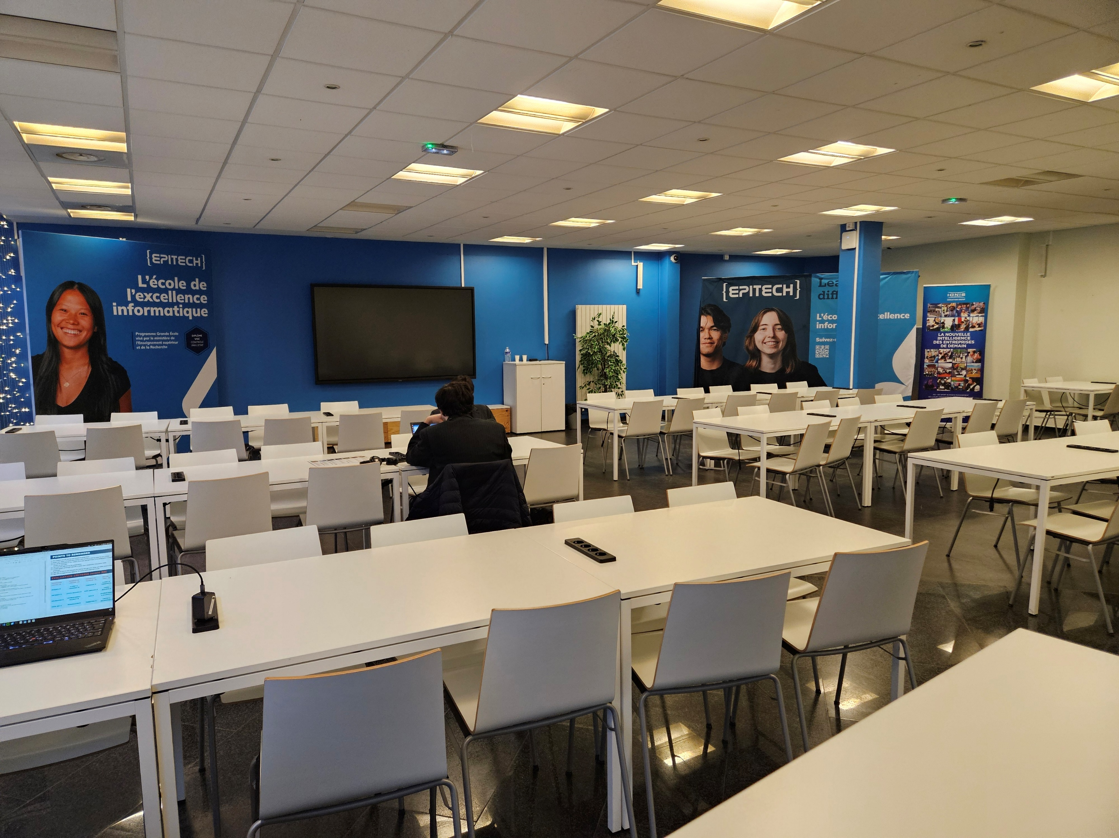
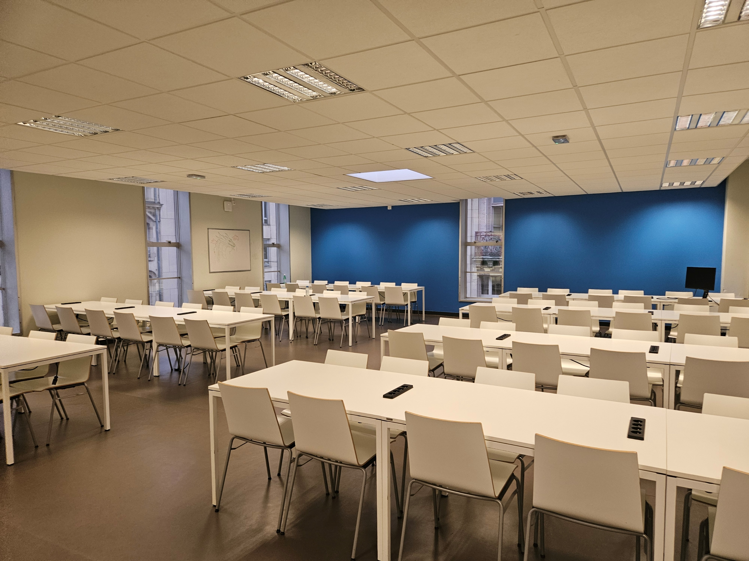
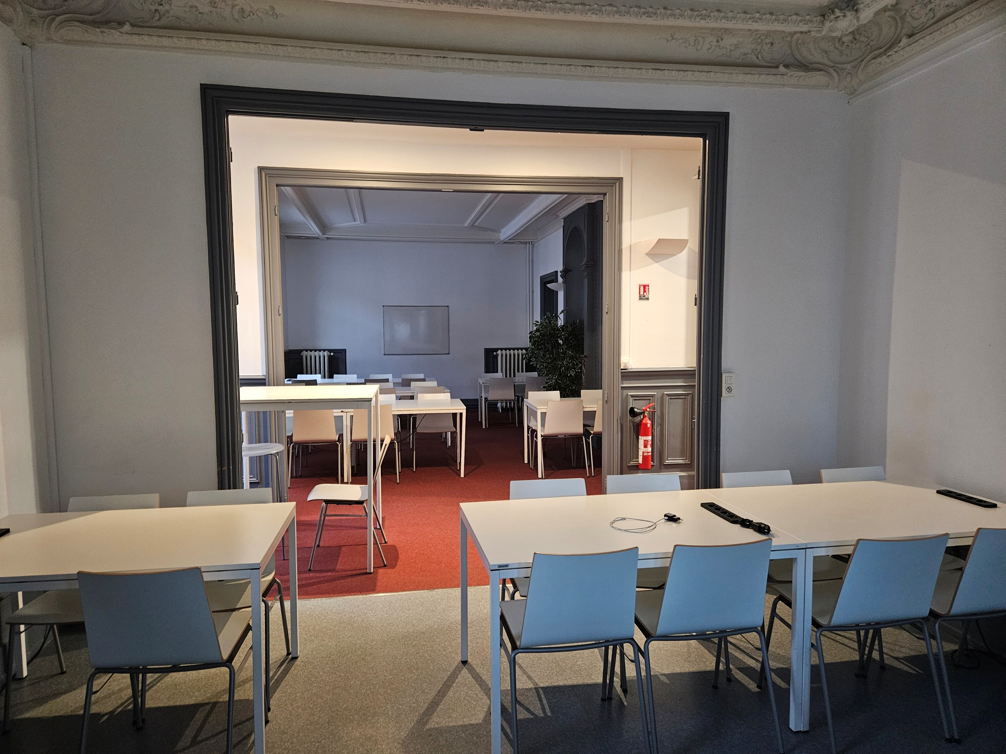
Current Design of EPITECH Nancy
001
In the center of Nancy
Bus Stop at 2min on foot and train station at 10 to 20min
~1.1km² of usable surface
201
105
3 stairs
3 amphitheaters
5 Small room on free access
GOSSOT Jean-Baptiste B-ENG-100

Slide 4
Aspect of the campus that needs improvement
GOSSOT Jean-Baptiste B-ENG-100

Slide 5


Adapt to people with mobility issues
We have an elevator who used a key.
Why not a keycard ?
GOSSOT Jean-Baptiste B-ENG-100

Slide 6
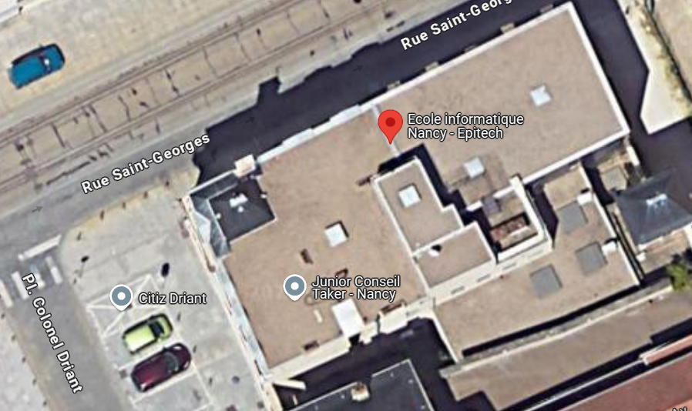
Adapt to reduce cost and energy usage
Solar Panel ?
Not let students open the door all the way when they’re smoking outside
GOSSOT Jean-Baptiste B-ENG-100

Slide 7


How would we use technology in the campus
We’ll learn how to use ChatGPT and Gemini to improve our knowledge
GOSSOT Jean-Baptiste B-ENG-100

Slide 8


Element of well-being and physical/mental health
Room 103 ? What does it serve ?
Could we use it to have a place where we could disconnect from coding, and have like a video game console ?
GOSSOT Jean-Baptiste B-ENG-100

Slide 9
Conclusion
To have a perfect campus in the future we could have :
One small room to detents yourself
Keycard for the elevator
Some solar panel on the roof and promoting more recycling
Learn to use AI to improve ourself in code
GOSSOT Jean-Baptiste B-ENG-100

